Slide 1
Xtreme Apps 2018
Ruffles

Slide 2




Themes
AI empowered chatbot to improve daily lives
Includes FAQ for Finance / Investment
Using AI to spot fake news
Cross-checking with recent BBC articles

Slide 3
Overview
User queries bot
Contextual Network Graph used to select article
QANet used to select answer
Chatbot returns response and link to article
Contextual Network Graph cannot find article
Chatbot returns “not found” response

Slide 4
Article Scrapping (Finance & Investment)

Slide 5
Part of Speech (POS) tagging
Textblob & nltk used to tag words (“Fly”, noun)
Words are filtered through list of stop words (we,I,you)
Capitalized sequence & sub-sequence of words treated as named entities (Sunday Times, Sunday, Times), and named entities have higher search weights

Slide 6
Singlish paraphrasing
Singlish words are paraphrased from a dictionary found at https://remembersingapore.org/2011/08/21/best-of-singlish-words-and-phrases/
ah lian -> teenage female hooligan
kay poh -> busybody

Slide 7
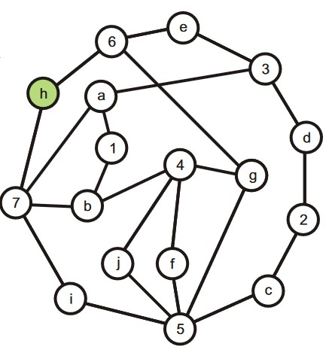
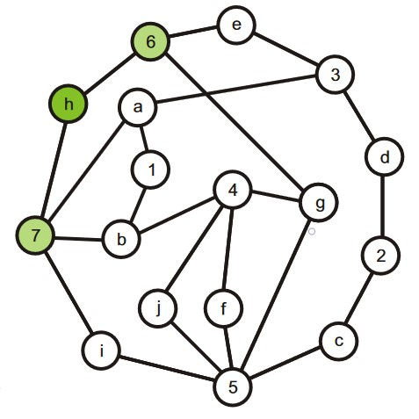
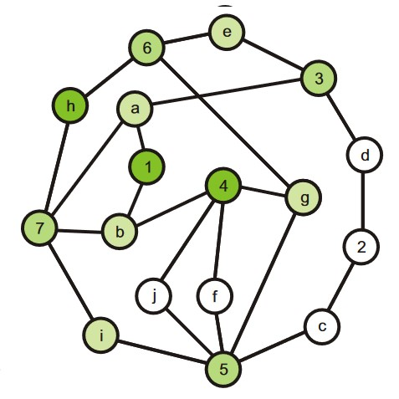
Contextual Network Graph (Search)
Search for word “h” in query with starting Energy E
Repeat for all words and return article with highest energy
Some energy propagated to articles 6 and 7, depending on weights
Repeat until Energy falls below threshold

Slide 8
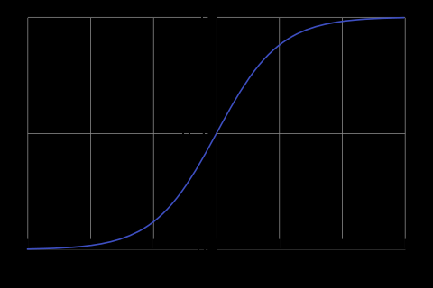

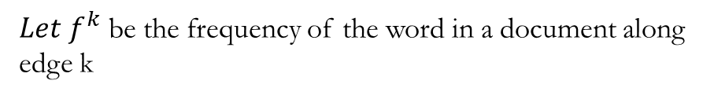

Contextual Network Graph (Search)
$Let f^{k}$ be the frequency of the word in a document along
edge k
${Weight}_{k}$ = $\frac{2e^{f_{k}}}{e^{max⁡(f_{1}, f_{2}, …f_{n})}+ e^{f_{k}}}$
Sigmoid function: Y = $\frac{e^{x}}{{1+e}^{x}}$

Slide 9
Chatbot
Telegram bot:
Responds to common queries (greetings)
Answers tagged queries (“@SaucePlzBot Where float si beh siao Trump balloon”) and provides link to reference

Slide 10

Relevance to Singapore

Slide 11
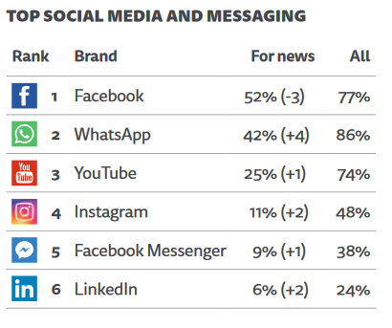
Fake news migration
Singapore
“The use of social media for news has started to fall in a number of key markets — after years of continuous growth. At the same time, we continue to see a rise in the use of messaging apps for news as consumers look for more private (and less confrontational) spaces to communicate.”
2018 Digital News Reports
Published by Reuters Institute

Slide 12

Fake news migration
“Young audiences were more likely to use WhatsApp, Instagram and Snapchat for news, partly because there was a growing desire to discuss news in relative privacy”

Slide 13

Application
Our chatbot:
Provides an easy means of fact-checking
Disrupts echo chambers by broadcasting news source to other members in the same chat
Can be easily extended to include data from other sources
Can be easily extended to include other topics
Can be easily extended to other chatbot APIs from other messaging apps
Can be extended to monitor trending rumors against protected Named Entities

